Slide 1
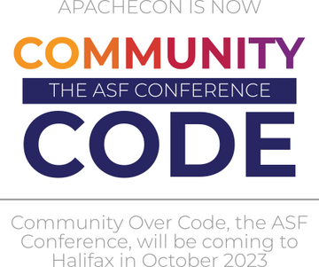

Open Source in Africa
And why you should be a part of it.
Presented By:
Abigail Mesrenyame Dogbe

Slide 2
My name is Abena because I was born on a Tuesday.

Slide 3
I hope this encourages you to contribute to the Open Source movement in Africa.

Slide 4
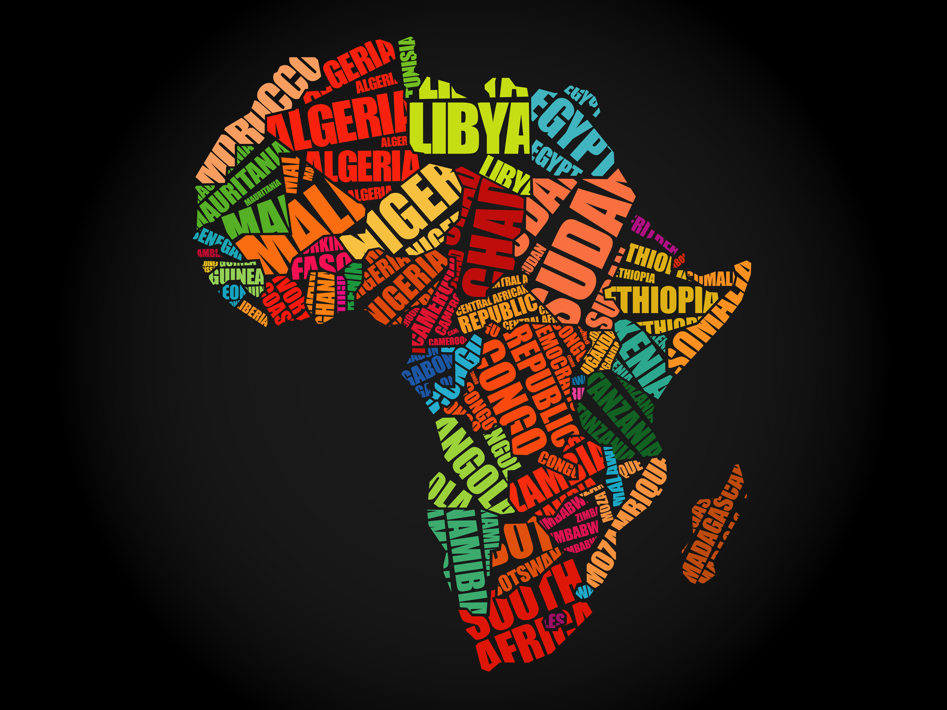
  1.3 Billion people - 54 countries
  Second largest population in the world
  Over 1600 different languages
  Open Source is uniting us

Slide 5
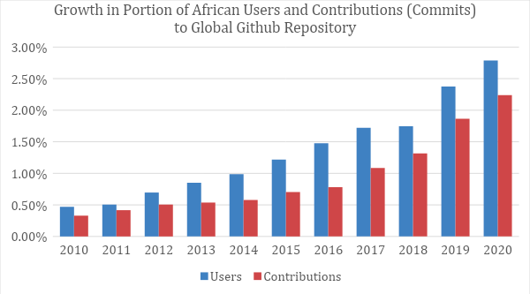
Github Authors and Contributors
  South Africa
  Egypt
  Kenya
  Nigeria
Trends of open source contributions from African users between 2010 and 2020 - ictworks.org, 2022.

Slide 6
Language
01.
Identity
Technology
02.
Community
03.

Slide 7
African Languages represent over 30% of the world’s languages.
Language
English, Spanish, French.
Technology is not yet available for many of these languages.

Slide 8
Masakhane - an Open Source NLP project aimed at addressing native African Language representation online.
How? Translating African Languages using machine learning
Built translation models based on Joey NMT for over 38 African languages

Slide 9
Zindi - the largest community of African Data Scientists.
Hone skills and provides job opportunities

Slide 10
  Made in Africa
  Encyclopedia of African History
Technology

Slide 11

Made in Africa
  Libraries
  Frameworks
  Extensions
  Query Builders
  Chatbots

Slide 12
In Arts - Nana Oforiatta Ayim’s Open-Source Encyclopedia of African History.
Cultural Encyclopedia Project
Documenting past, present, and future African arts and culture (starting with Ghana)

Slide 13
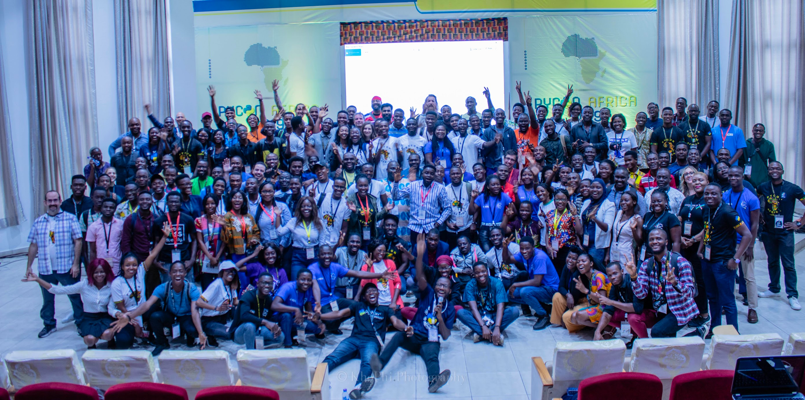
COMMUNITY

Slide 14

  PyCon Africa
  OSCA - Open Source Community Africa
  Everything Open Source
  CHAOSS Africa
  Django Girls
  She code Africa
  Linux User Group of Mauritius

Slide 15


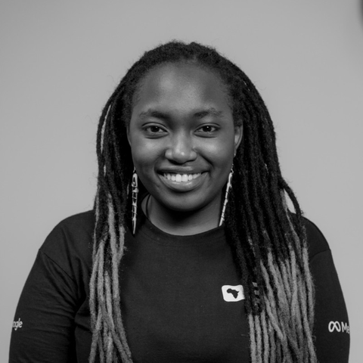


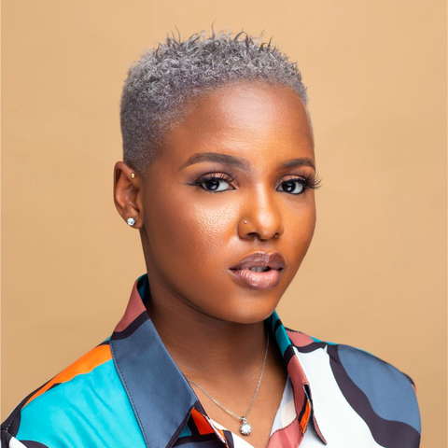
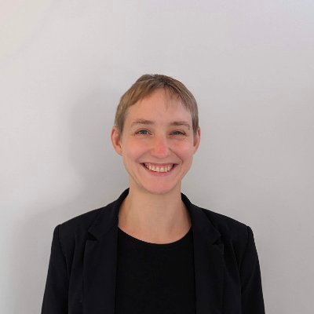
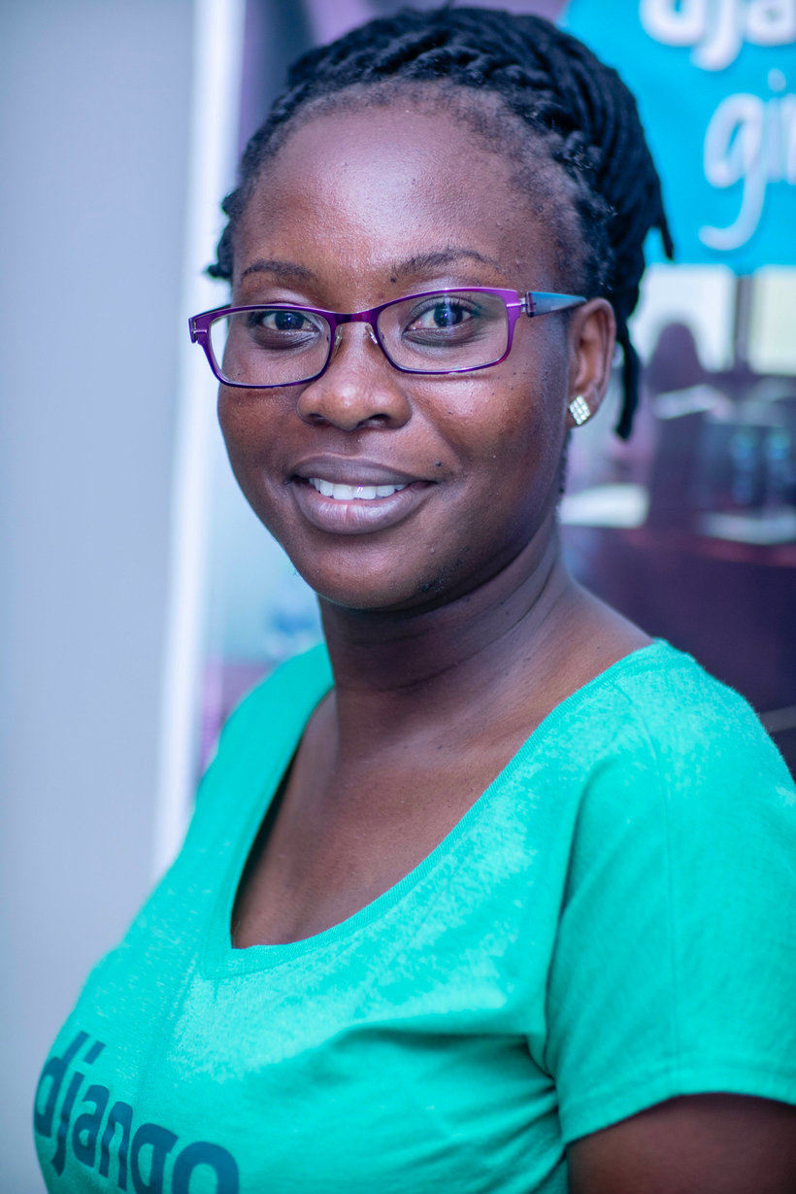
Marlene Manghami
Samson Goddy
Velda Kiara
Mannie Young
People Leading the Open Source movement in Africa
Yaa Nuamah
Ruth Ikegah
Sheena Oconnell
Anna Makarudze

Slide 16
  Opportunities (especially for junior developers)
  Resources
  Travel and Visas
Challenges

Slide 17
I want to accomplish more through Everything Open Source and Research.

Slide 18
Why should you be a part of this?

Slide 19
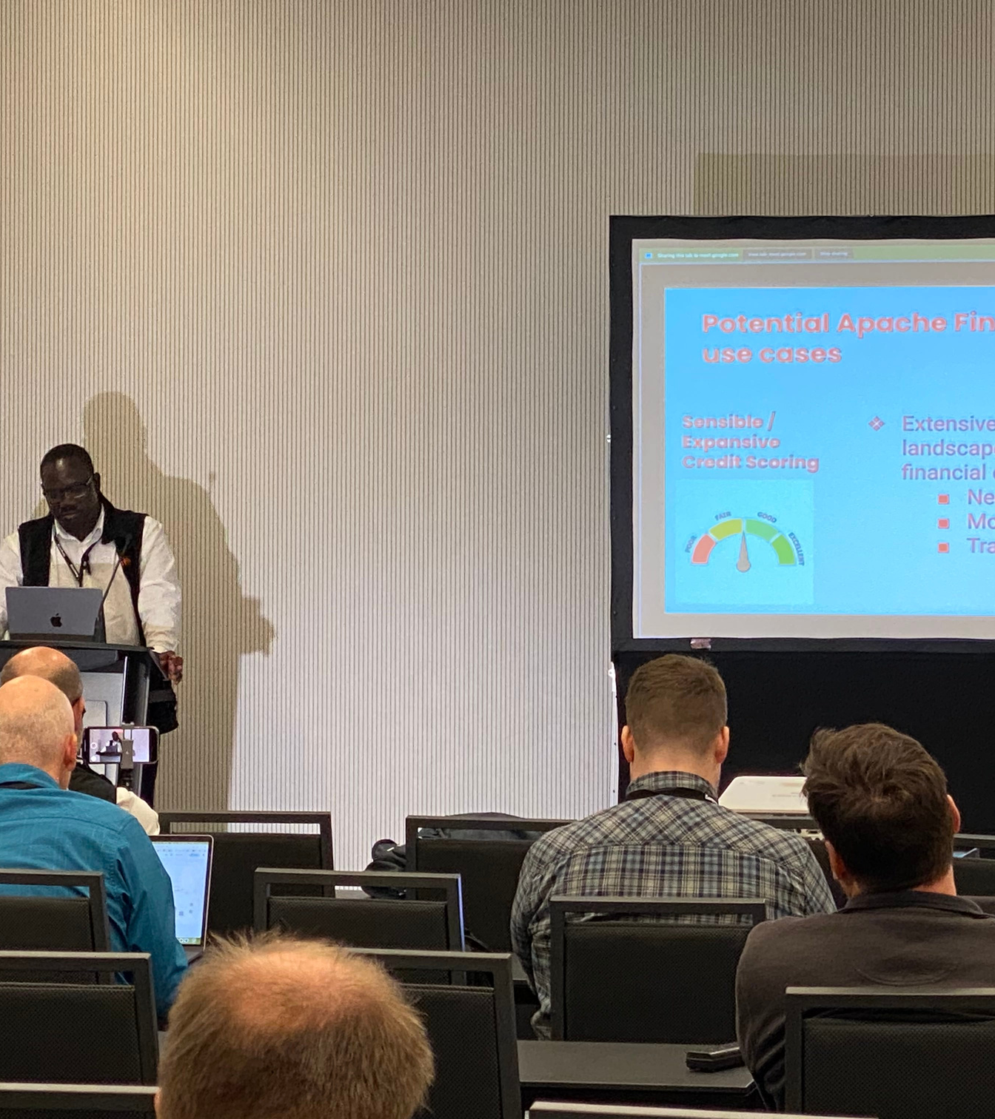
We are at work, right here, making an impact while bringing others to open source.
How do you intend to help?
Community Over Code Africa, next?

Slide 20



Thank you!
Let’s connect!
@mesrenyamedogbe

