Slide 1
Lessons Learned from Benchmarking Amazon’s E-commerce Search Engine

Slide 2
Notes:
Why you are

Slide 3
Design a benchmarking framework for Amazon product search
Notes:
What is the task

Slide 5
Indexer
“phone”
Searcher
“phone”
Notes:
IR basics

Slide 6
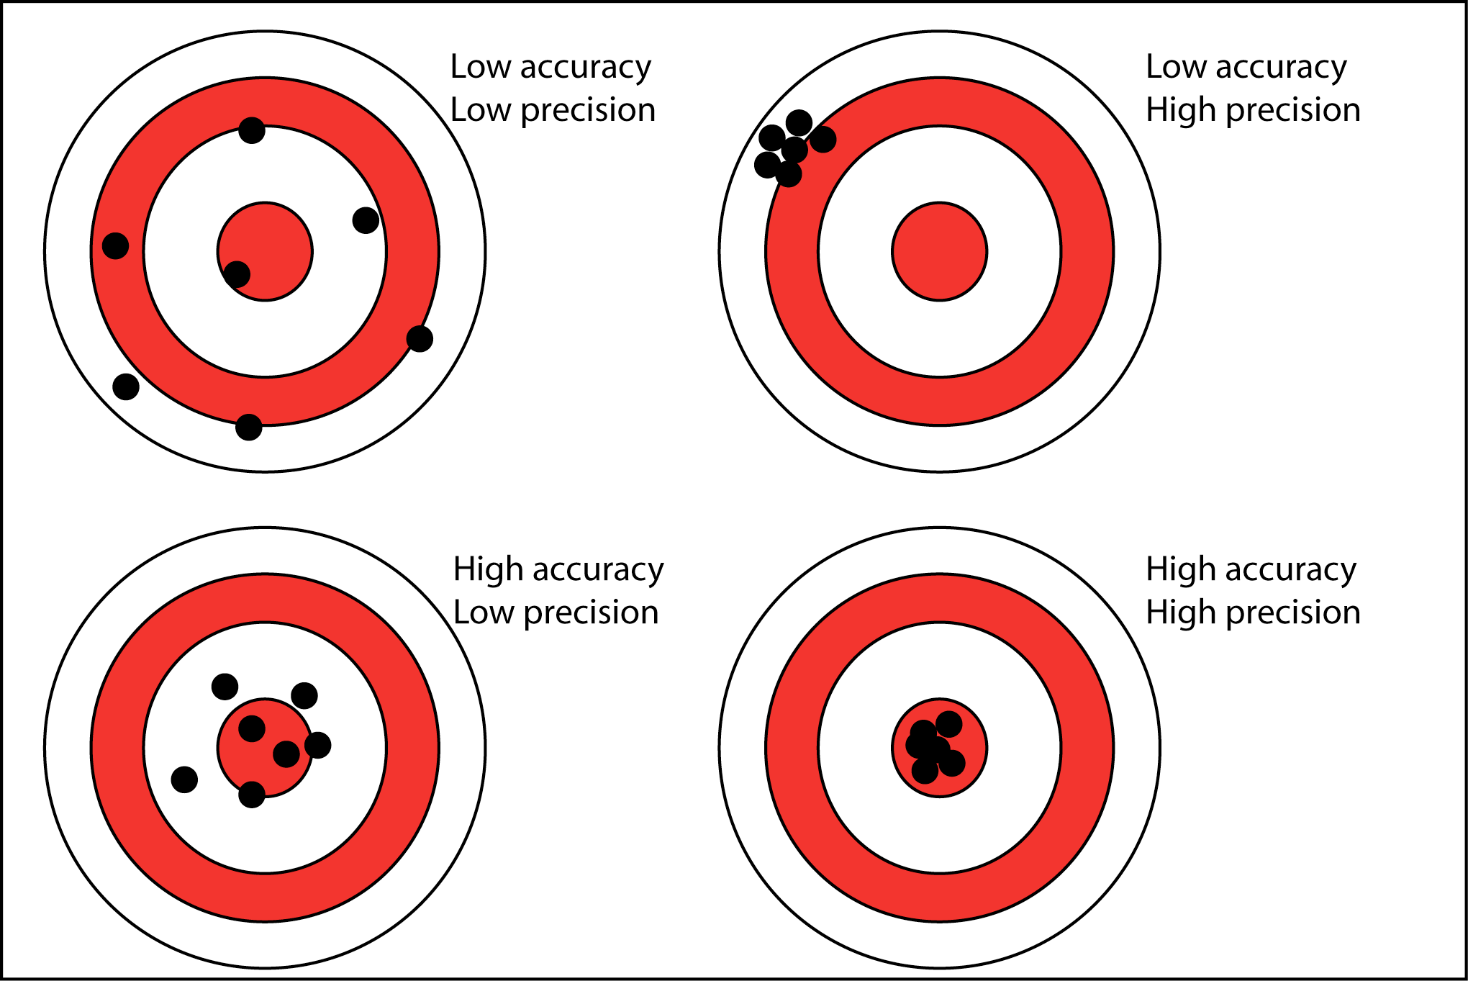
Prod-like
Accurate
Precise
Fast
Notes:
Requirements

Slide 7
Average / mean
P50 / median
P99
Notes:
What we measure

Slide 8
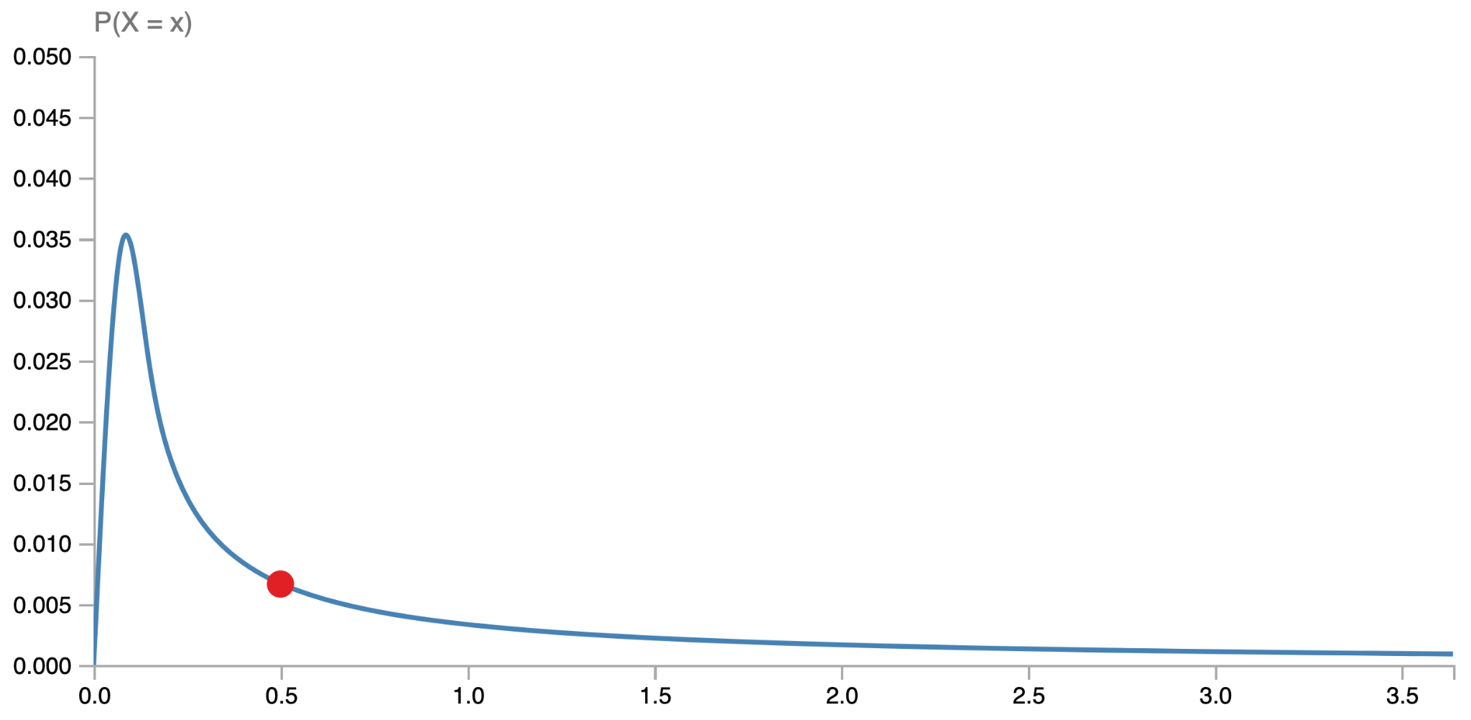
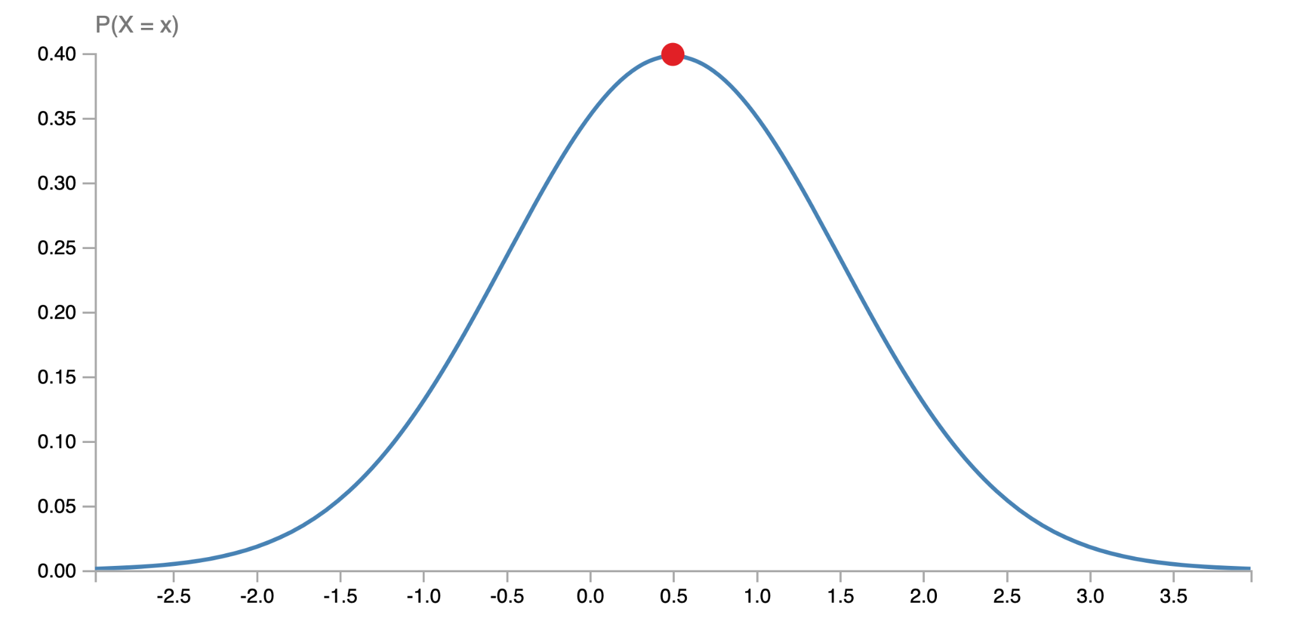
Notes:
Same percentile, different distributions Lognormal: u=-0.7; s=120 Normal: u=0.5; s=1
statdist.com

Slide 9
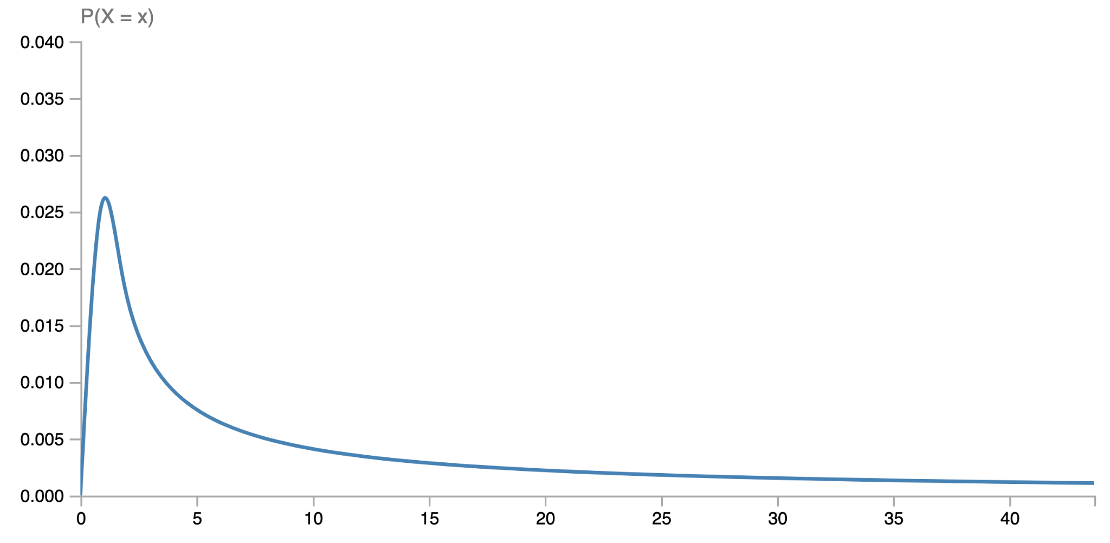
(fraction)
p0 = 0
p50 = 5
avg = 10
p90 = 40
(ms)
Notes:
Pinned distribution Lognormal: u=8; s=7

Slide 10
Lessons
Measure multiple points along the distribution of the metric.
Notes:
Lessons

Slide 11
p50: 5 p90: 41 p99: 53
p50: 5 p90: 38 p99: 57
p50: +0% p90: -7.3% p99: +7.5%
Notes:
Comparing distributions

Slide 12
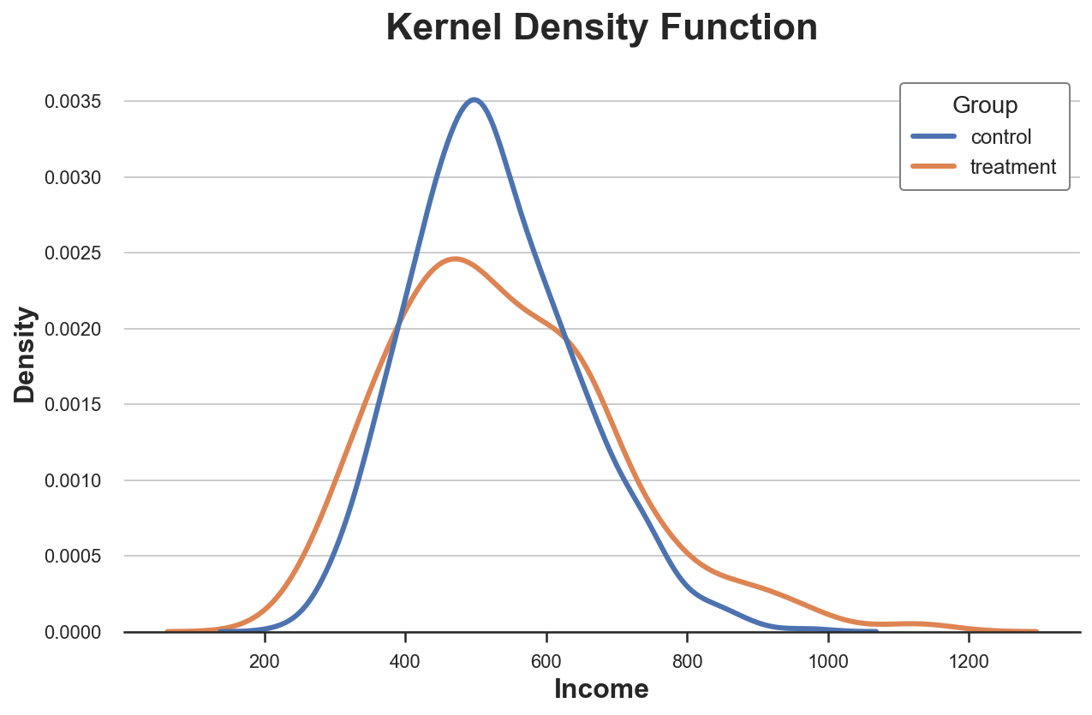
baseline
candidate

Slide 14
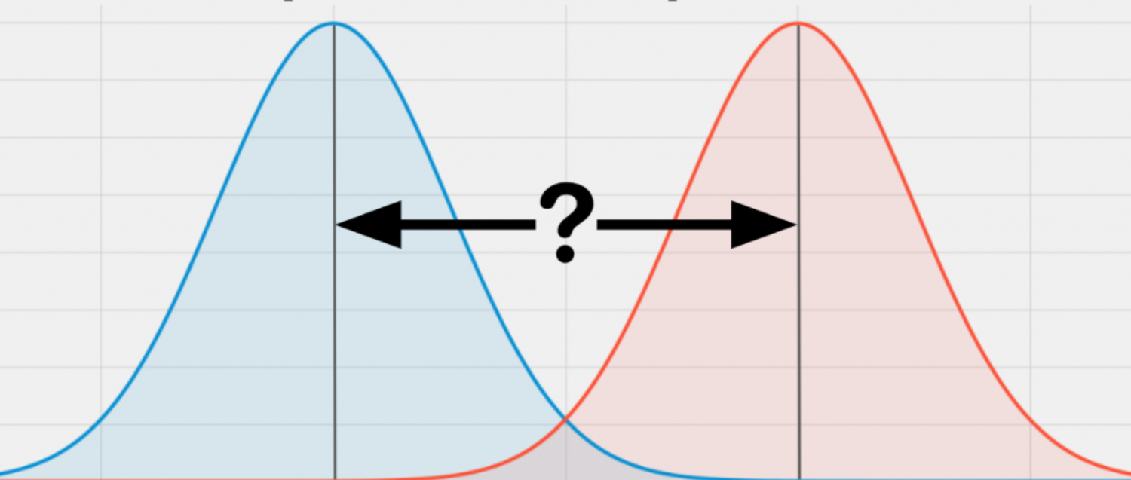

Slide 15
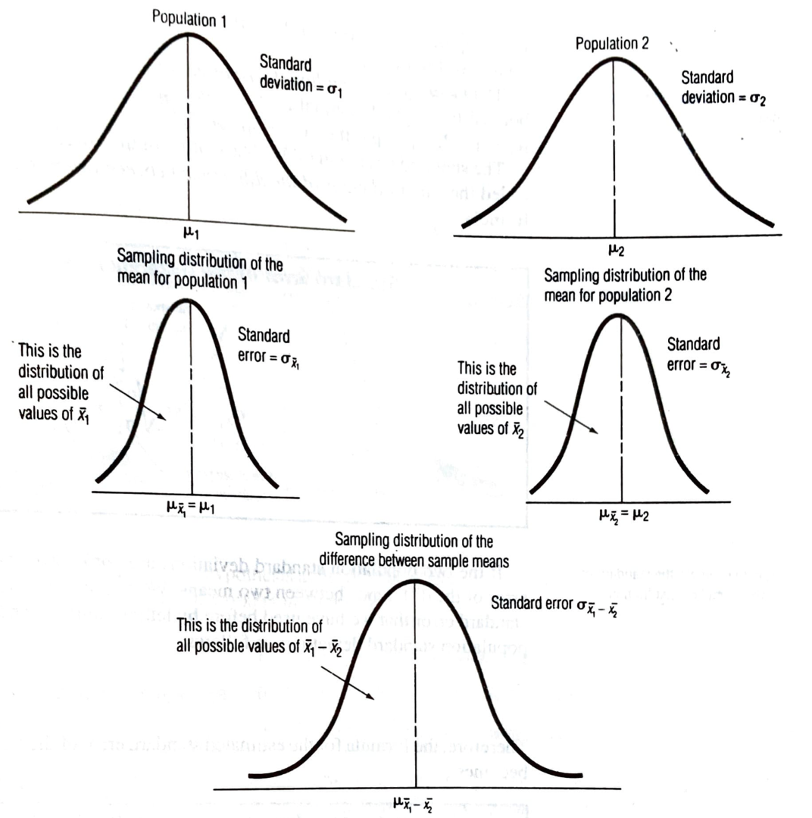
Notes:
Quantitative Analysis 2, Orr

Slide 16
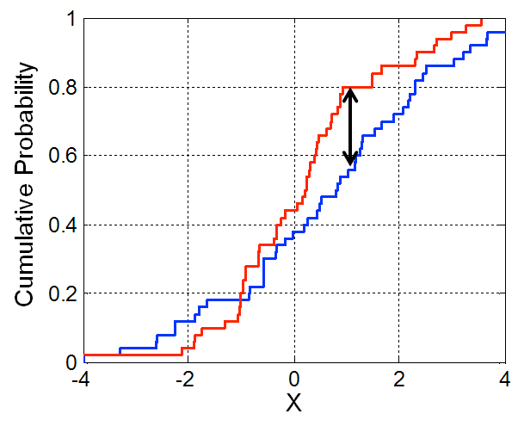
Notes:
KS test

Slide 17
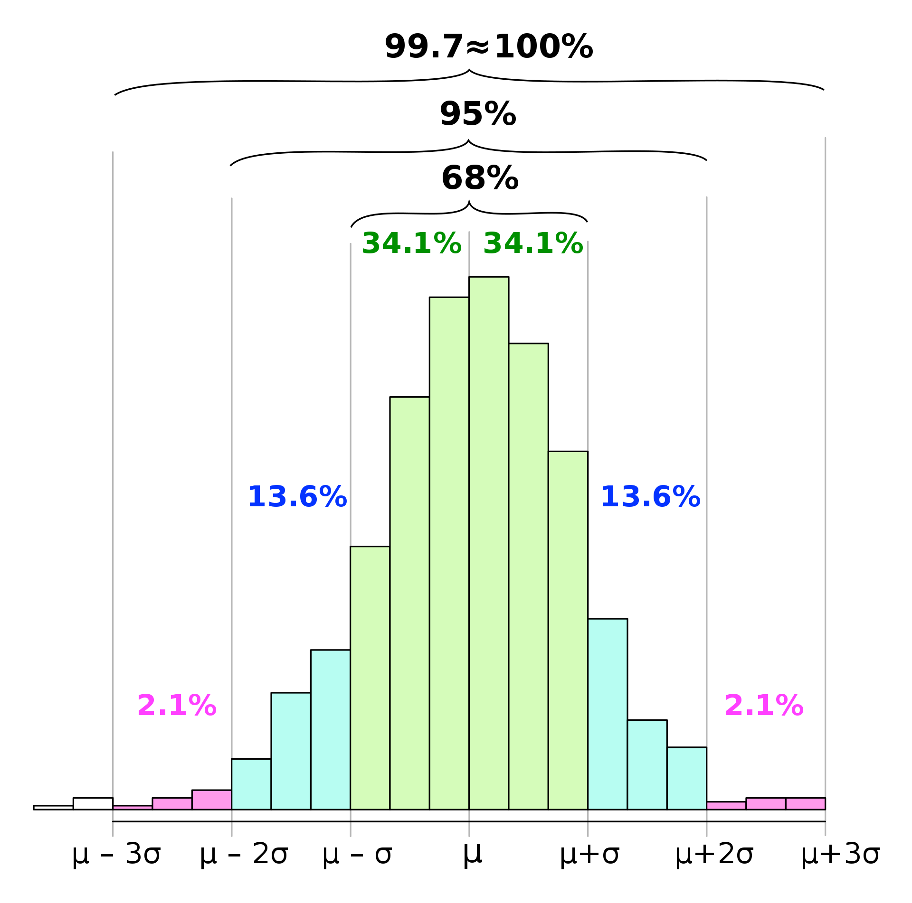
Notes:
Chebyshev

Slide 18
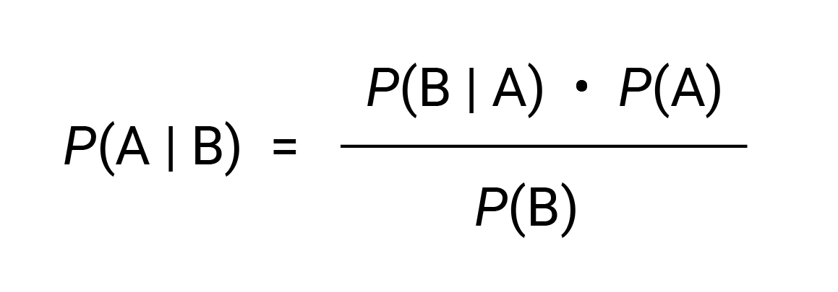
Likelihood
Prior
Posterior
Marginal
Notes:
Bayes’ theorem

Slide 19
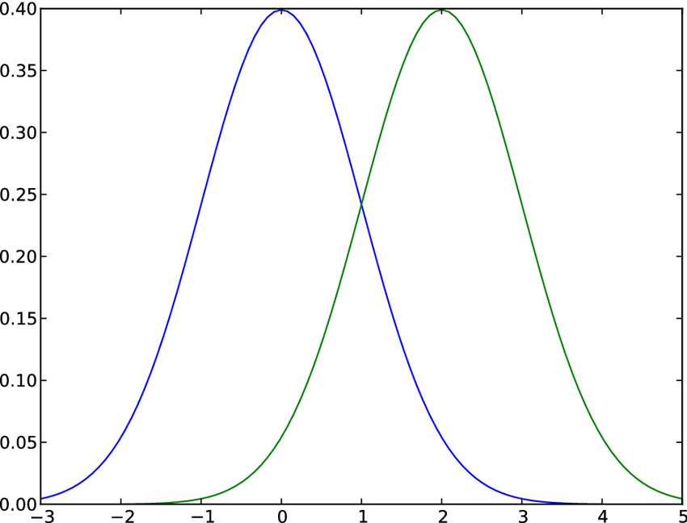
P = 0.7
P = 0.6

Slide 20
$$P\left(B\right|X)=\frac{P\left(B\right) P\left(X\right|B)}{P\left(B\right) P\left(X\right|B)+P\left(C\right) P\left(X\right|C)}$$
$$P\left(B\right|X) −probability that X belongs to the baseline B$$
$$P\left(B\right)−probability that any observation belongs to baseline B$$
$$P\left(X | B\right)−probability of observing X assuming it belongs to B$$
$$P\left(C\right)−probability that any observation belongs to change C$$
$$P\left(X | C\right)−probability of observing X assuming it belongs to C$$

Slide 21
Lessons
Measure multiple points along the distribution of the metric.
Use statistical tests to measure the significance of a change.
Notes:
Lessons

Slide 22
$$P\left(B\right|X)=\frac{P\left(B\right) P\left(X\right|B)}{P\left(B\right) P\left(X\right|B)+P\left(C\right) P\left(X\right|C)}$$
$$P\left(B\right)−probability that any observation belongs to baseline B$$
$$P\left(X | C\right)−probability of observing X assuming it belongs to C$$

Slide 23
p50: +3% p90: -2% p99: +0%
p50: +0% p90: -1% p99: +7%
Notes:
A/A and A/B tests

Slide 24
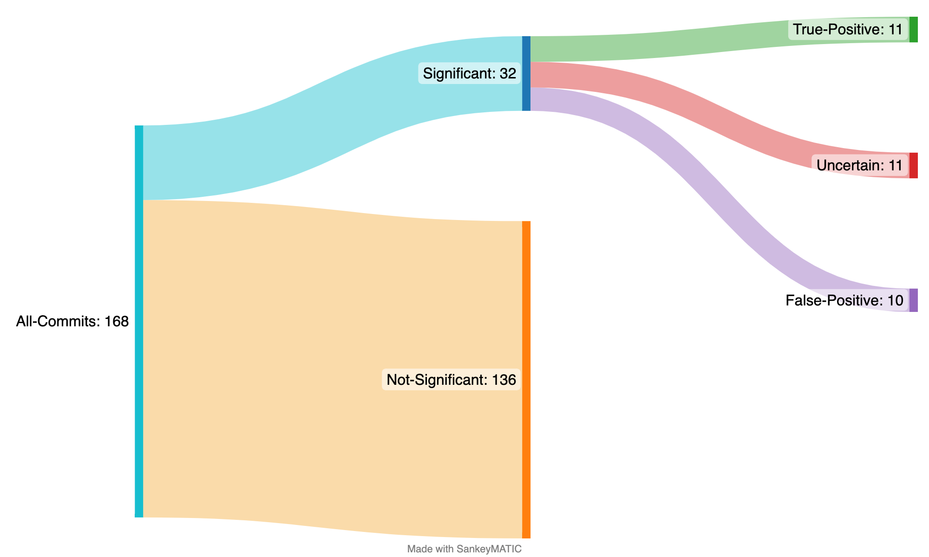
Notes:
Involved A/B detection https://sankeymatic.com/build/

Slide 25
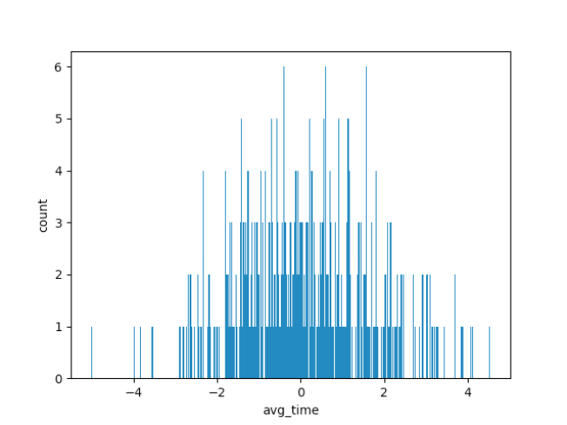
Average latency difference across benchmark runs
(ms)
Notes:
Noise distribution

Slide 26
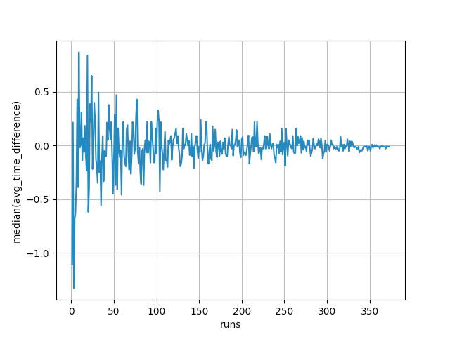
Median converging
(ms)

Slide 27
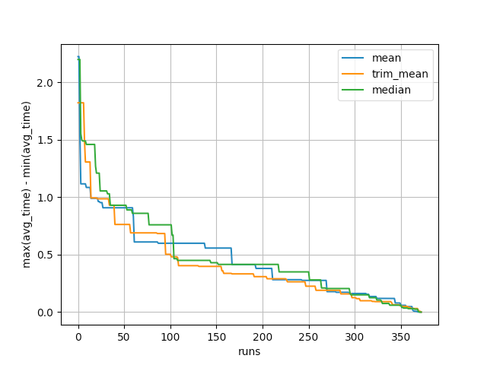
Expected error
(ms)

Slide 28
Lessons
Measure multiple points along the distribution of the metric.
Use statistical tests to measure the significance of a change.
Run A/A tests and understand the noise and bias characteristics of your benchmarking process.
Notes:
Lessons

Slide 29
Indexer
Searcher
“phone”
Notes:
IR basics

Slide 30
1 thread / segment 1 ms / doc
50
50
50ms
+80%
90
90ms
10
Notes:
How index geometry influences search performance

Slide 31
Single Thread
Notes:
Single-threaded indexing

Slide 32
Force Merge
Notes:
Force-merge

Slide 33
Notes:
Index rearrange

Slide 34
Lessons
Measure multiple points along the distribution of the metric.
Use statistical tests to measure the significance of a change.
Run A/A tests and understand the noise and bias characteristics of your benchmarking process.
Evaluate the noise distribution and mitigate noise that is introduced by the application or by the benchmarker.
Notes:
Lessons

Slide 36
Sample documents
Sample queries
Index
documents
Run queries
-60%

Slide 37
Lessons
Measure multiple points along the distribution of the metric.
Use statistical tests to measure the significance of a change.
Run A/A tests and understand the noise and bias characteristics of your benchmarking process.
Evaluate the noise distribution and mitigate noise that is introduced by the application or by the benchmarker.
Make benchmarks reliable and fast. If you can’t do both, at least make the trade-off configurable.
Notes:
Lessons

Slide 38
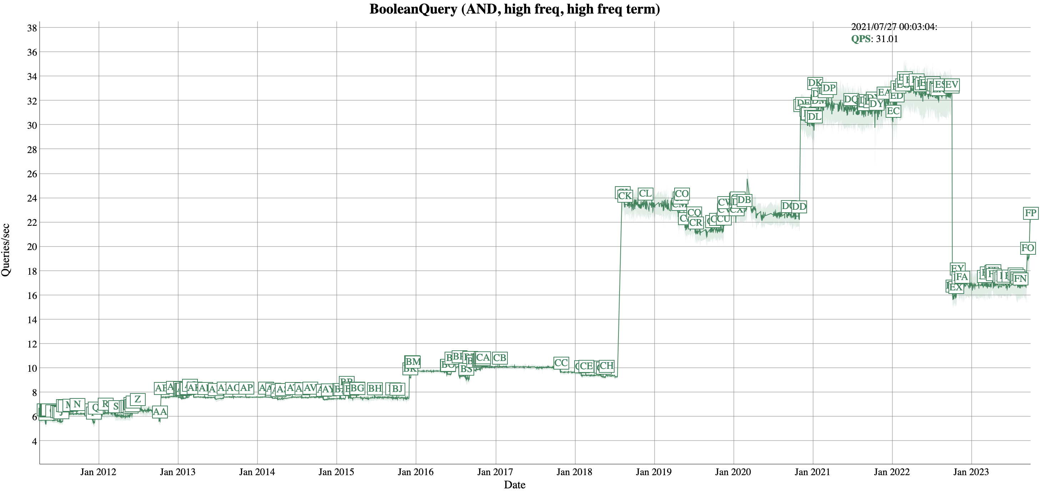

Slide 39
Lessons
Measure multiple points along the distribution of the metric.
Use statistical tests to measure the significance of a change.
Run A/A tests and understand the noise and bias characteristics of your benchmarking process.
Evaluate the noise distribution and mitigate noise that is introduced by the application or by the benchmarker.
Make benchmarks reliable and fast. If you can’t do both, at least make the trade-off configurable.
Notes:
Lessons

