Slide 1


How to participate and contribute to an Apache project as a non-developer, Apache Solr edition
Alejandro Arrieta
Sr Staff Customer Operations Engineer
October 2023

Slide 2
AGENDA
Who I am
How I started using Apache Solr and Friends
Should I get involved? Trip to Apache Con 2022
Solr community changes in 2022-2023
How to contribute as non-developer
Next year(s) goals

Slide 3
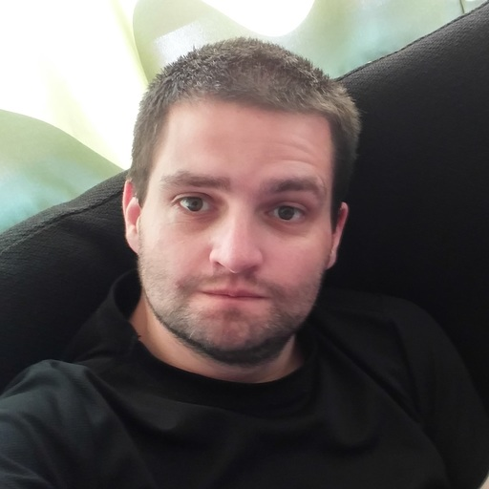
Who I am
Alejandro Arrieta
Sr Staff Customer Operations Engineer
Cloudera
Solr SME / Ambari SME
BS CS + Informatics Eng + Master IT UTFSM
Chile, South America

Slide 4
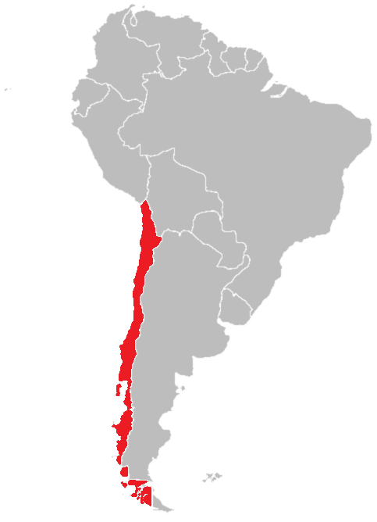
Who I am
Alejandro Arrieta
Sr Staff Customer Operations Engineer
Cloudera
Solr SME / Ambari SME
BS CS + Informatics Eng + Master IT UTFSM
Chile, South America

Slide 5
AGENDA
Who I am
How I started using Apache Solr
Should I get involved? Trip to Apache Con 2022
Solr community changes in 2022-2023
How to contribute as non-developer
Next year(s) goals

Slide 6
How I started using Apache Solr
Solr is the popular, blazing-fast, open source enterprise search platform built on Apache Lucene™.

Slide 7
How I started using Apache Solr
2017 joined Hortonworks
Assigned to become expert in Ambari and Solr
Support other Apache projects like
  HDFS, Yarn, Ranger, Atlas, Spark, Kafka, Nifi, Zookeeper, Hive and friends
Cloudera and Hortonworks merge
Assigned to Data Processing Pillar supporting:
  Solr, Yarn, Spark, Kafka, Nifi

Slide 8
How I started using Apache Solr
CDP 7.1.9 has Solr based on Apache Solr 8.11.2 (latest of 8 branch)
  HDFS or local fs indexes, kerberos, ranger authorization
  Indexers like: MRIT, Spark Crunch, Spark connector, Lily Hbase NRT, Lily Hbase batch
Solr versions I supported: 4, 5, 6, 7 and 8

Slide 9
AGENDA
Who I am
How I started using Apache Solr
Should I get involved? Trip to Apache Con 2022
Solr community changes in 2022-2023
How to contribute as non-developer
Next year(s) goals

Slide 10
Should I get involved? Trip to Apache Con 2022
Five plus years working with Solr and other Apache projects
Pandemic restrictions lifted
Apache Con 2022 with Search track including Solr talks
OK, lets check the Apache Way and Community over Code in person.
Waifu approves plan!

Slide 11
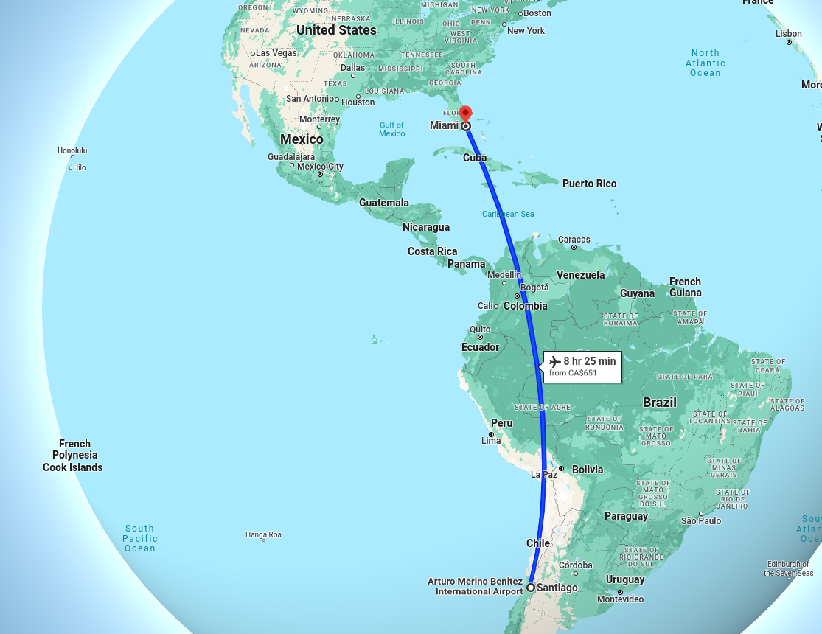
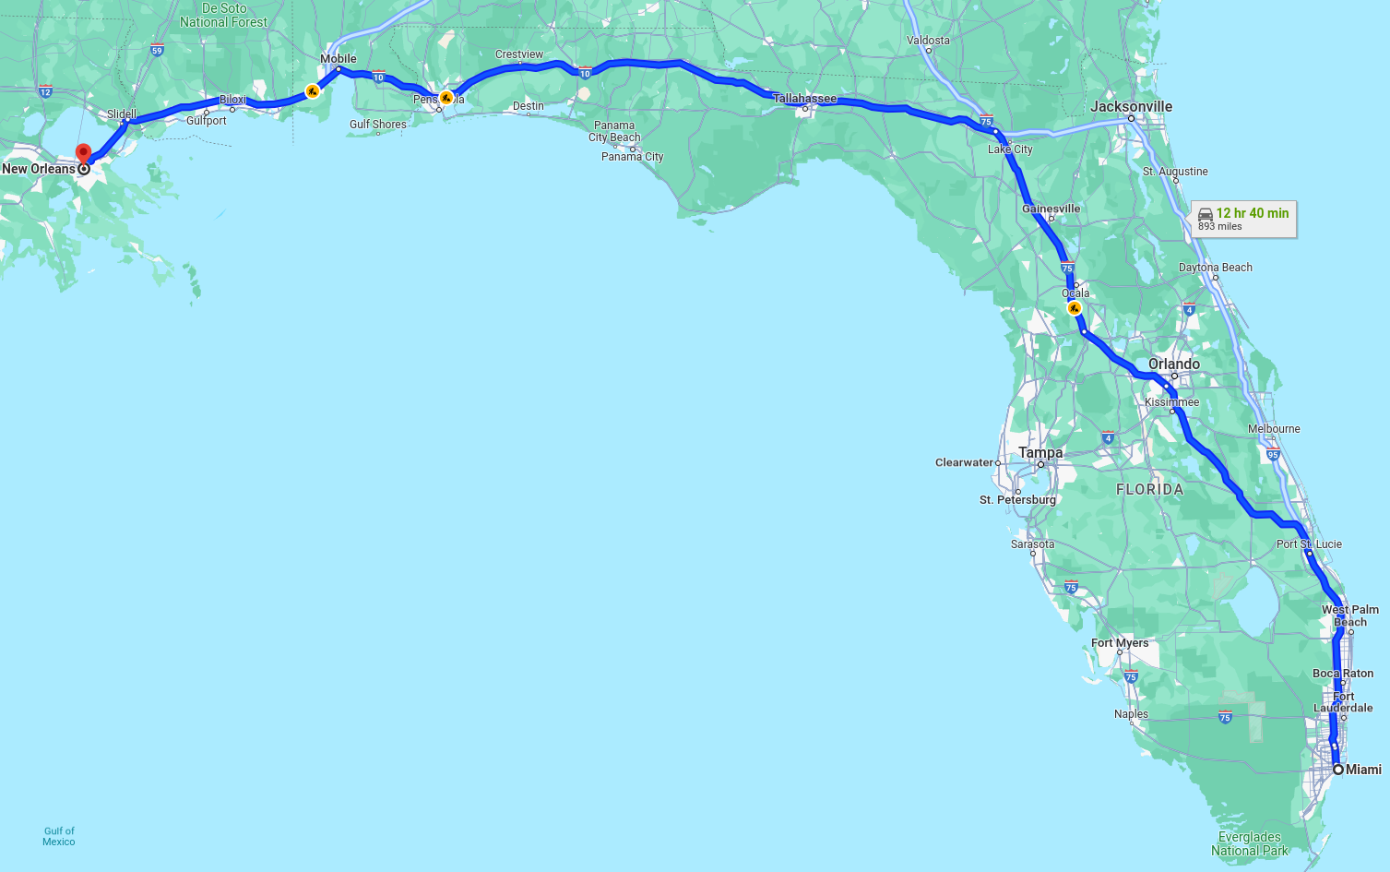
Should I get involved? Trip to Apache Con 2022

Slide 12

Should I get involved? Trip to Apache Con 2022
Solr and other Apache
Projects Committers
(expectation)

Slide 13
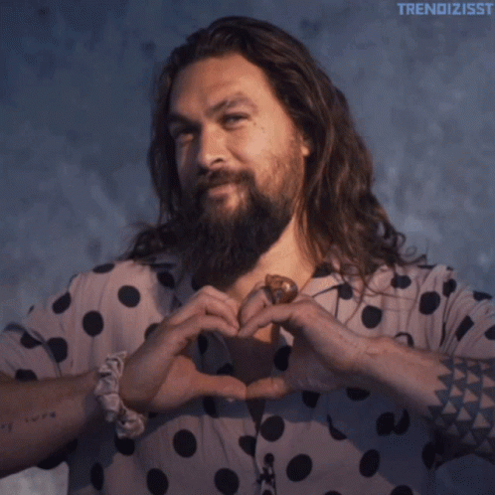
Should I get involved? Trip to Apache Con 2022
Solr and other Apache
Projects Committers
(reality)

Slide 14
Should I get involved? Trip to Apache Con 2022
Everyone is super nice and welcoming.
Awesome Search track talks and from other tracks
Eric Pugh talk “I Became a Solr Committer in 4662 Days. Here’s how you can do it faster!”
Solr birds of a feather (BoF) organized by David Smiley and lead by Eric Pugh, Ashum Gupta, Michael G, Jason Gerlowski and Alessandro Benedetti.

Slide 15
AGENDA
Who I am
How I started using Apache Solr
Should I get involved? Trip to Apache Con 2022
Solr community changes in 2022-2023
How to contribute as non-developer
Next year(s) goals

Slide 16
Solr community changes in 2022-2023
New Solr PMC chair David Smiley March 2023
New Committers Colvin Cowie, Justin Sweeney, Andy Webb, Marcus Eagan, Alex Deparvu.
New Solr PMC Michael Gibney December 2022

Slide 17
Solr community changes in 2022-2023
Two Contributor Workshops November 2022 organized by Eric Pugh and Jason Gerlowski
Third Contributor Workshop and Solr Contributor Office Hours December 2022 organized by Eric Pugh and Jason Gerlowski
Monthly Solr Virtual Meetup starting January 2023 organized by Jason Gerlowski and others.

Slide 18
Solr community changes in 2022-2023
Having periodic workshops/meetups is awesome:
  Seeing and listening to others even if virtually creates bigger human bonding than only email/slack/forum.
  Proposed topics have preference, but anyone can present or ask at the end of the meetup.
  Being periodic helps reserving time to attend, generally 3rd or 4th week of the month. Organized in mailing list and meetup group.

Slide 19
AGENDA
Who I am
How I started using Apache Solr
Should I get involved? Trip to Apache Con 2022
Solr community changes in 2022-2023
How to contribute as non-developer
Next year(s) goals

Slide 20
How to contribute as non-developer
Download, use and read documentation of the project.
Join mailing lists, irc, forum, slack. Read and reply if you know the answer to a question.
Attend any virtual/in person meetup or conference, talk to members of the community.
Generate content like blogs, videos, tutorials related to the project.

Slide 21
How to contribute as non-developer
Documentation or official web can have errors, typos or can be improved.
Propose and work on things missing or not updated frequently like:
  Newsletter
  New blogs/documentation
  Social media presence Linkedin, twitter/X, propose creating the account and generate content so the project is more visible.
  Share the project content on your social media.

Slide 22
How to contribute as non-developer
If project does not have youtube/blog/other, use your own account and create content related to the project.
You may not be an user of the project, but have talent in web/ui/ux design, graphics, video creation, type writing, others. Helping the project may help your portfolio/demo book.
If you find an issue report it to the mailing list or create a Jira. Include how to reproduce the issue.

Slide 23
How to contribute as non-developer
My contributions so far
Joined mailing list and slack channels, read all threads and reply if I know the answer.
Attend every meetup/virtual conference if possible. One in Japan timezone.
Released Solr Newsletter proposal starting September 2023, working on October 2023 release.
Tested and voted (non binding) on Solr 9.x release candidates.

Slide 24
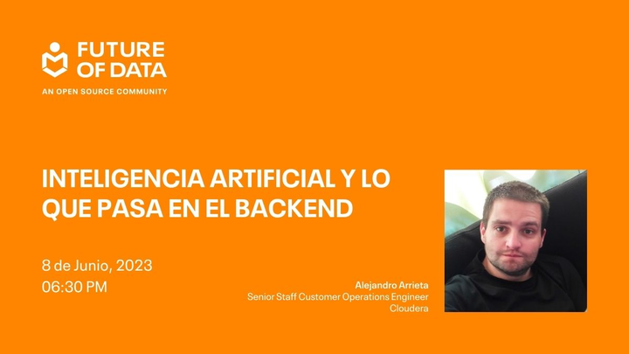
How to contribute as non-developer
My contributions so far
Talk about Solr at
Future of Data
Santiago Chile
June 2023
Opensource Community
in Spanish

Slide 25

How to contribute as non-developer
My contributions so far
Talk at Community over Code
(ex Apache Con)
Halifax Canada,
“How to participate and
contribute to an Apache
project as a non-developer,
Apache Solr edition”
October 2023

Slide 26
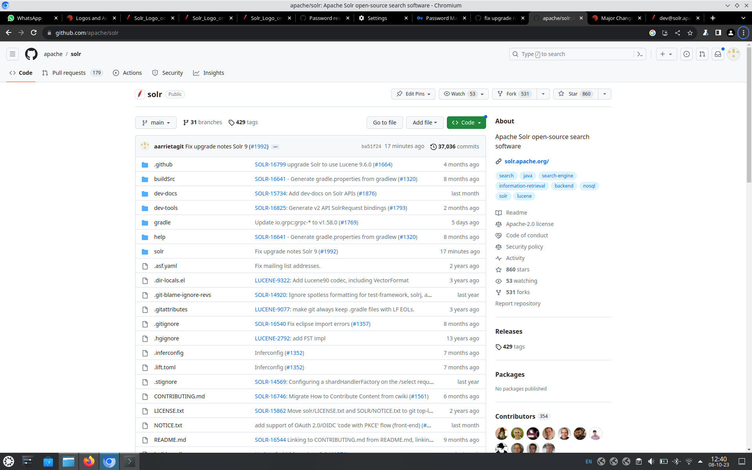
How to contribute as non-developer
My contributions so far
First documentation change
PR submitted and
merged/approved.
More to come.

Slide 27
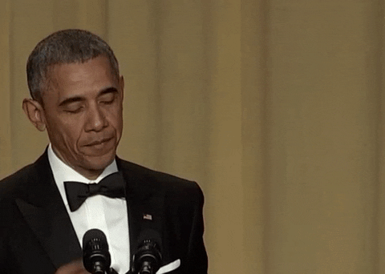
How to contribute as non-developer
My contributions so far
First documentation change
PR submitted and
merged/approved.
More to come.

Slide 28
AGENDA
Who I am
How I started using Apache Solr
Should I get involved? Trip to Apache Con 2022
Solr community changes in 2022-2023
How to contribute as non-developer
Next year(s) goals

Slide 29
Next year(s) goals
Attend next Community over Code/Apache Con 2024 if possible.
Contribute with documentation
Continue with Solr newsletter (if accepted)
Create content like videos and blogs about Solr
Push for Solr social media accounts missing like Linkedin.

Slide 30
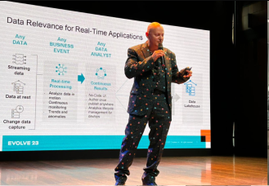
Next year(s) goals
Be Solr advocate
giving a few talks
on local meetups
(like Tim Spann)

Slide 31
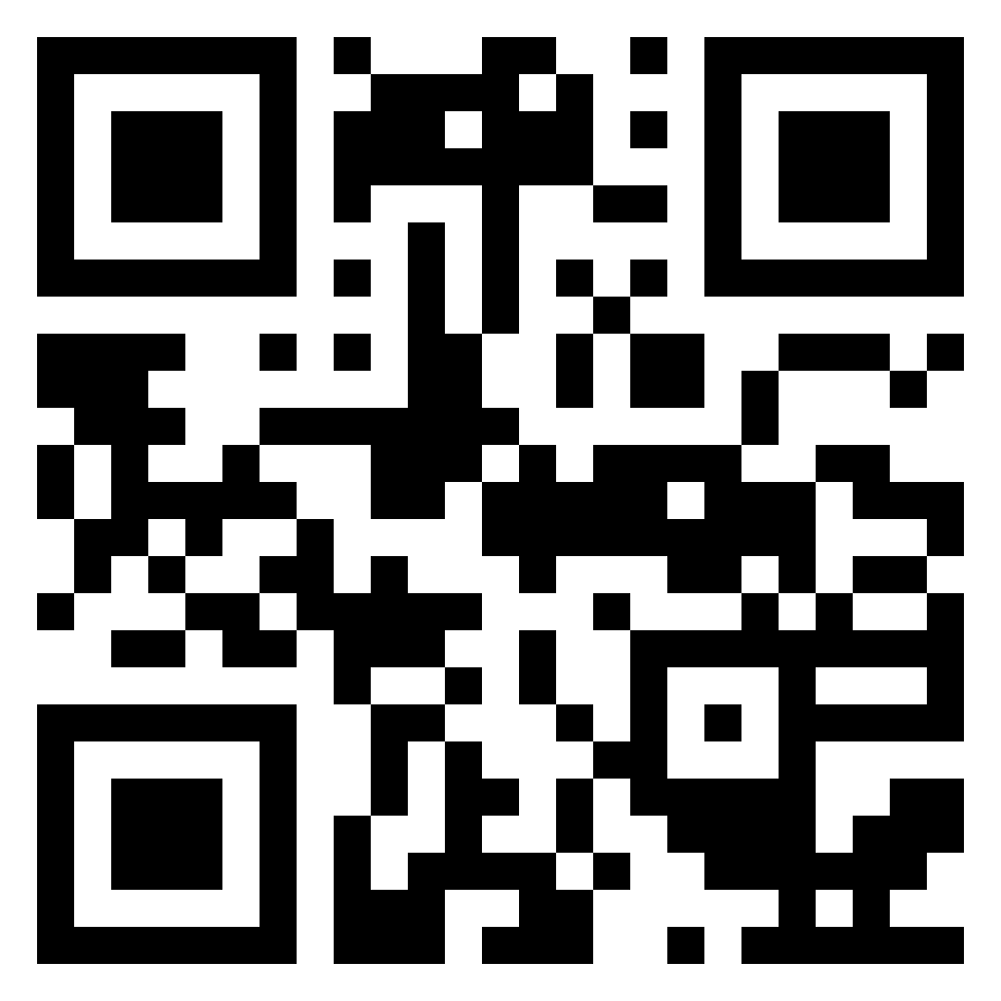
Next year(s) goals
This presentation and
all future content will
be available at
searchistheway.com

Slide 32
THANK YOU

